Slide 1
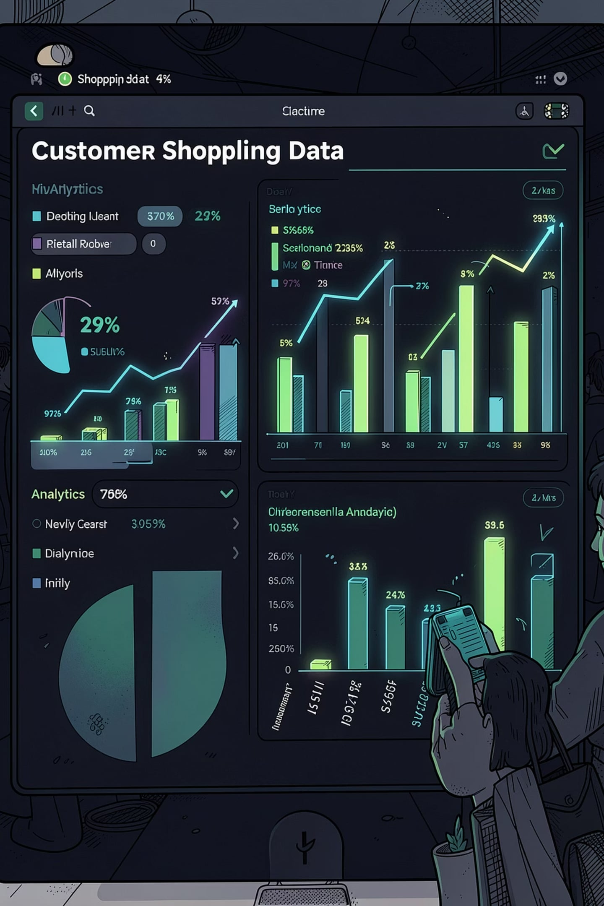
Customer Shopping Behavior Analysis
Uncovering spending patterns, customer segments, and product preferences across 3,900 transactions

Slide 2
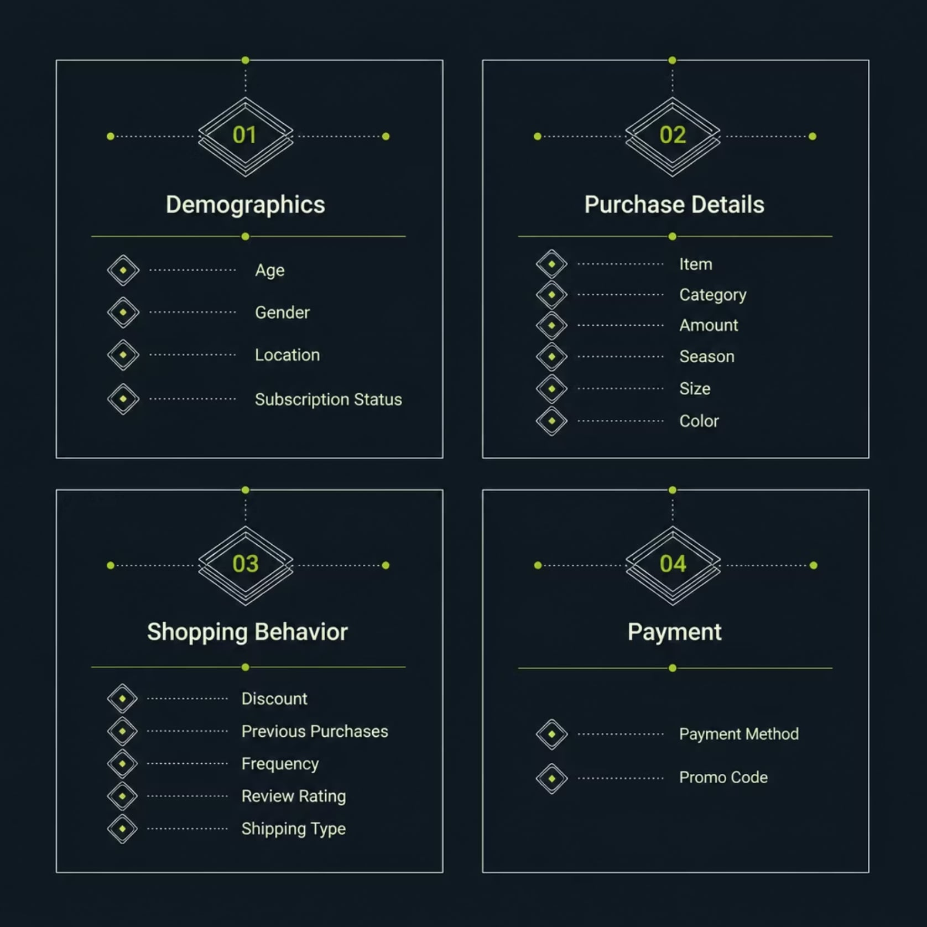
Dataset at a Glance
3,900
18
37
Transactions
Columns
Missing Values
Review Rating only
Key Feature Groups
Customer demographics
Purchase details
Shopping behavior
Payment methods

Slide 3




Data Preparation in Python
Load & Explore
1
Imported via pandas; df.info() & .describe()
Clean
2
Imputed missing Review Ratings by category median; standardized to snake_case
Engineer
3
Created age_group bins & purchase_frequency_days; dropped redundant promo_code_used
Load to DB
4
Connected to PostgreSQL; loaded cleaned DataFrame for SQL analysis

Slide 4
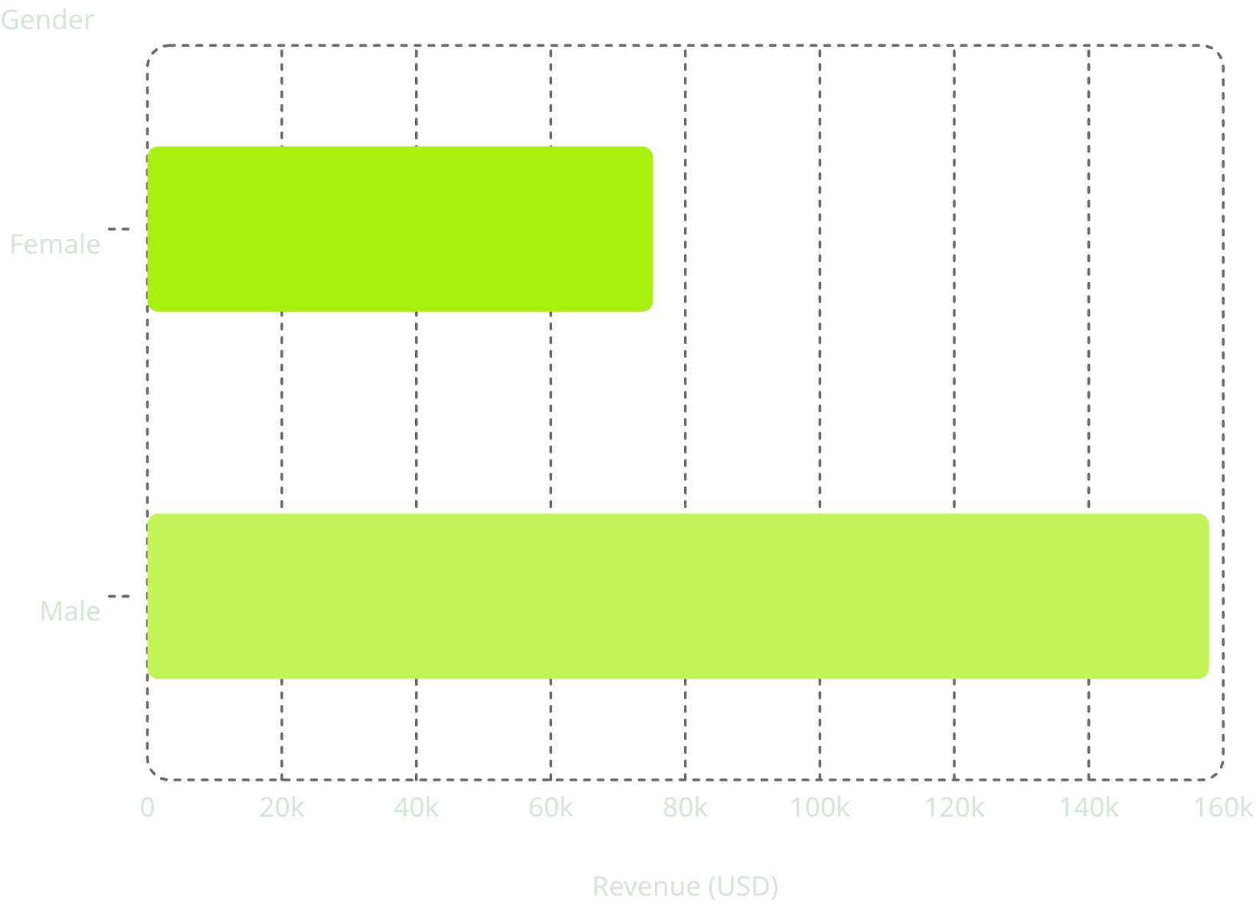

Revenue by Gender
Key Finding
Male customers generated 2.1× more revenue than female customers — a critical insight for targeting and segmentation.
Male revenue: $157,890 vs. Female: $75,191

Slide 5
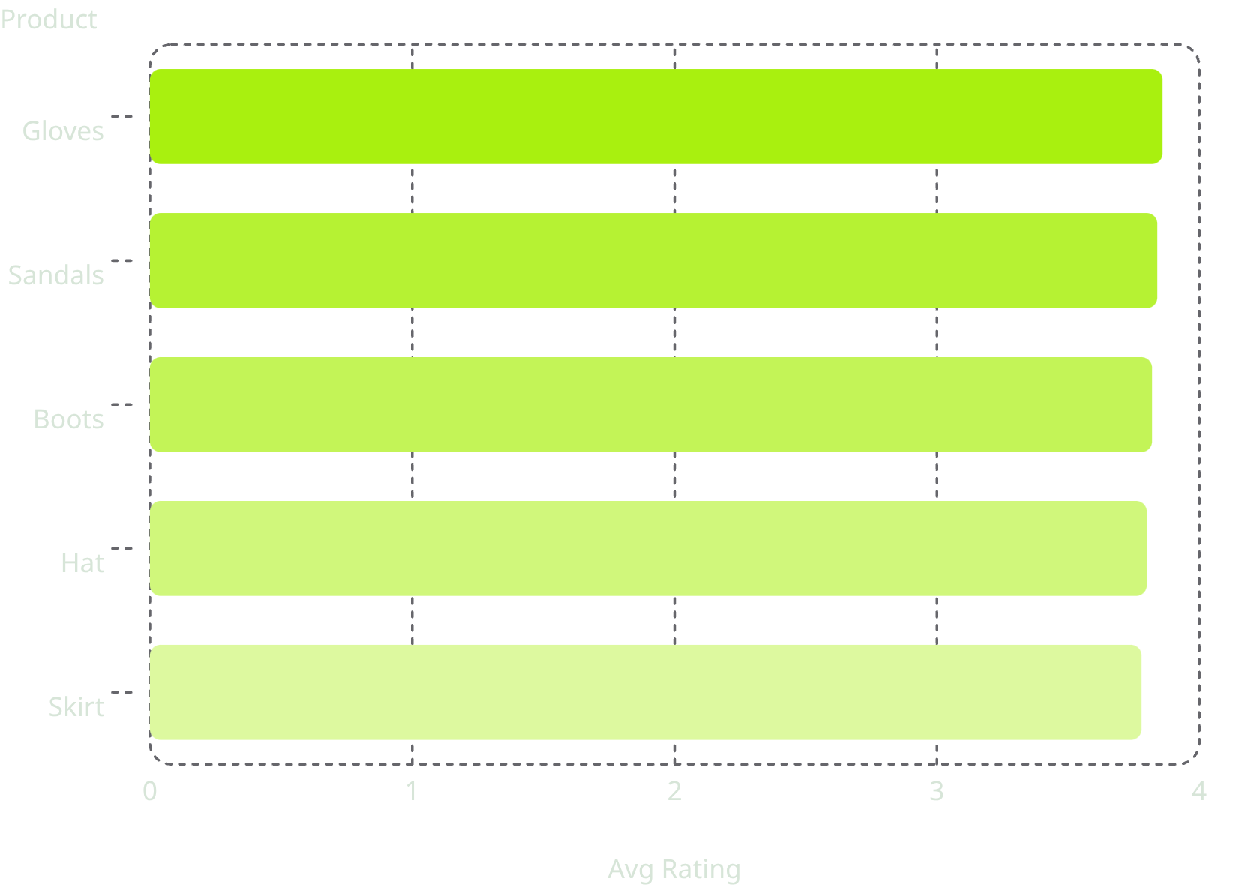


Products, Ratings & Discounts
Top 5 Products by Avg Rating
Most Discount-Dependent Products
Hat
Sneakers
50.00% discounted purchases
49.66% discounted purchases
Coat
49.07% discounted purchases

Slide 6
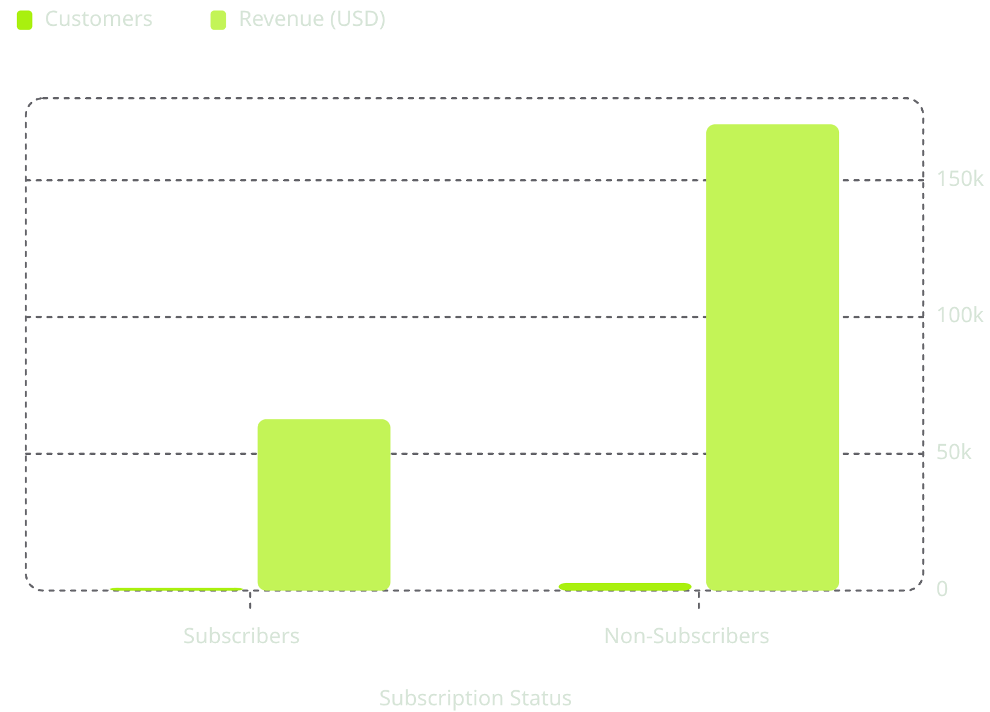
Subscribers vs. Non-Subscribers
Insight
Non-subscribers outnumber subscribers 2.7× (73% vs 27%) and drive $170K vs $62K in revenue.
Avg spend is nearly identical (~$59.50), suggesting subscription conversion is an untapped opportunity.

Slide 7
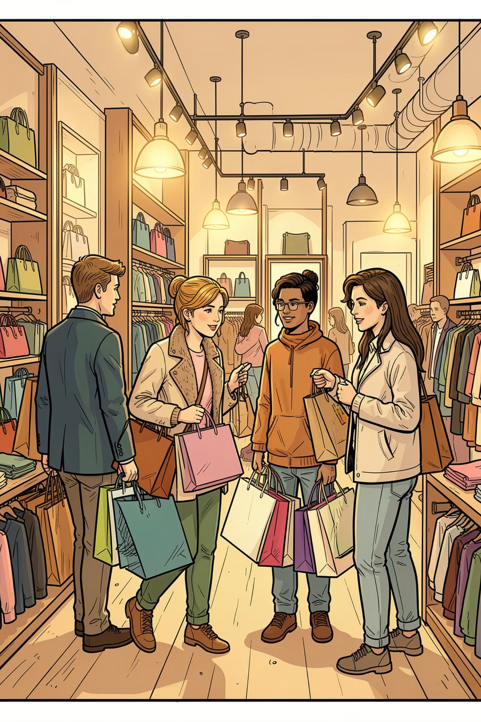
Customer Segmentation
🏆 Loyal
🔄 Returning
3,116 customers
701 customers
🆕 New
83 customers
Repeat buyers with >5 purchases: 958 subscribers vs. 2,518 non-subscribers

Slide 8
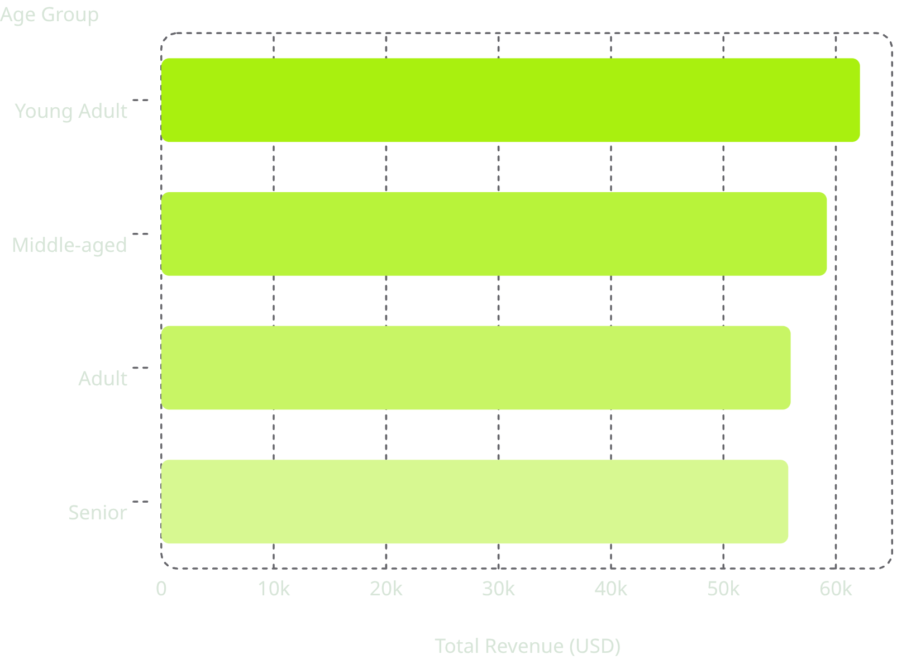

Revenue by Age Group
Key Takeaway
Young Adults lead in revenue contribution, but all four age groups are relatively balanced — suggesting broad market appeal across demographics.
Express shipping avg: $60.48 vs. Standard: $58.46

Slide 9
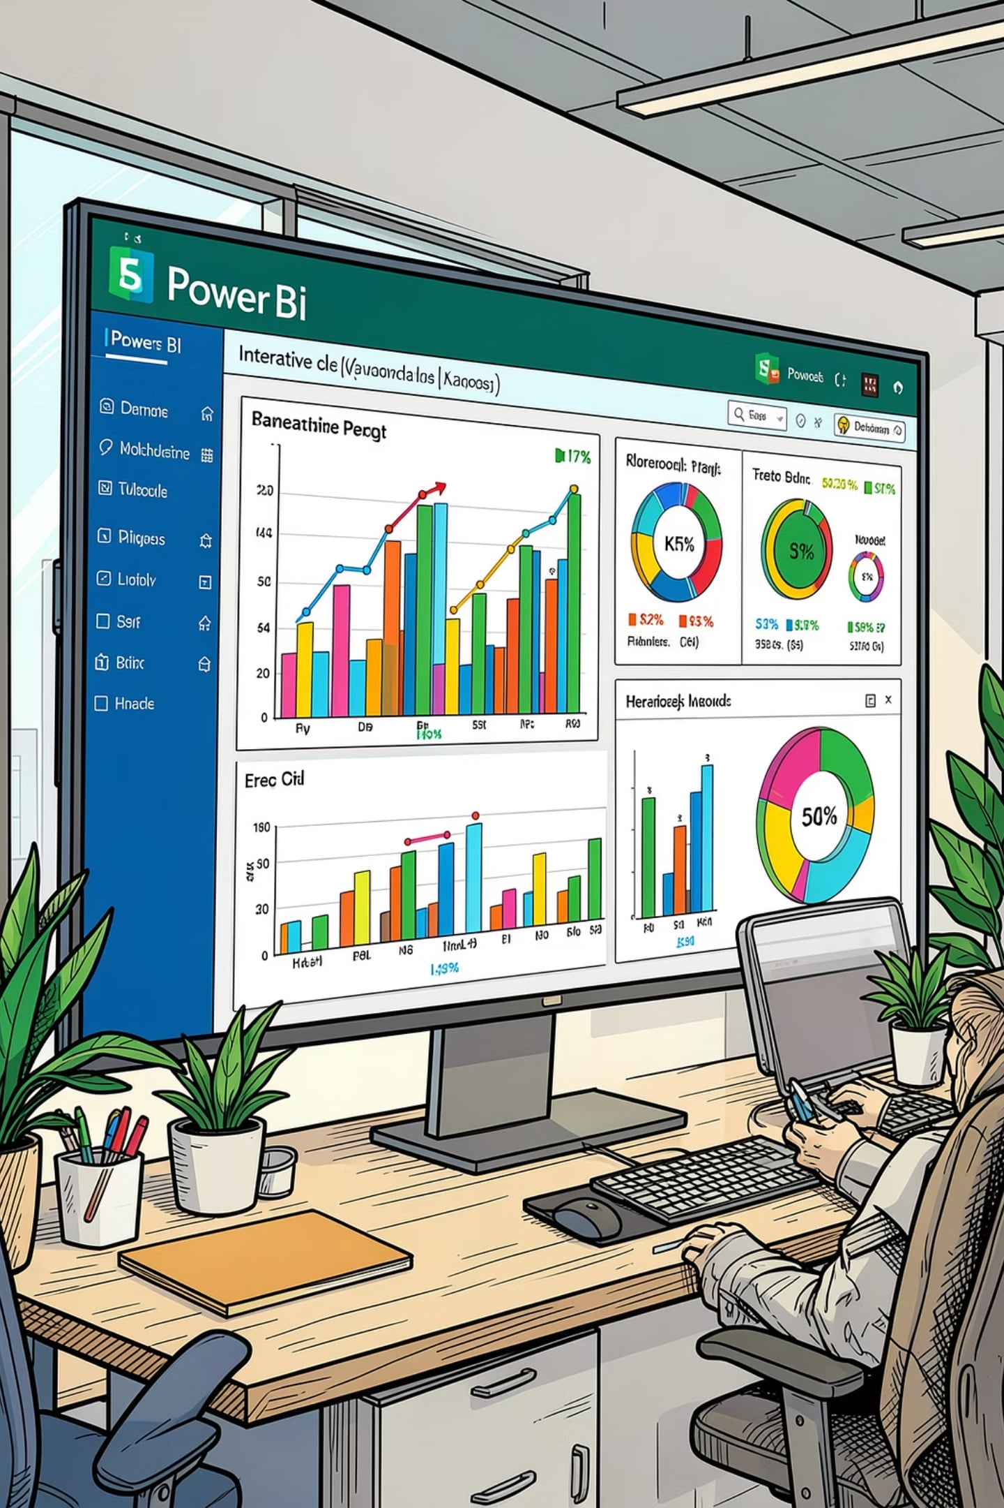




Power BI Dashboard
3.9K Customers
$59.76 Avg Purchase
3.75 Avg Rating
27% Subscribers
Interactive filters: Gender · Category · Shipping Type · Age Group

Slide 10

Business Recommendations
Boost Subscriptions
Promote exclusive subscriber benefits
Loyalty Programs
Reward repeat buyers → Loyal segment
Review Discount Policy
Balance sales lift vs. margin control
Product Positioning
Highlight top-rated & best-sellers
Targeted Marketing
Focus on high-revenue age groups & express-shipping users

